Slide 1
Docker Fundamentals
Suman Debnath

Slide 2
Agenda
Introduction to Virtualization Technologies
Container based Virtualization
Docker Architecture
Docker based Web-Application

Slide 3
It’s all about Applications

Slide 4
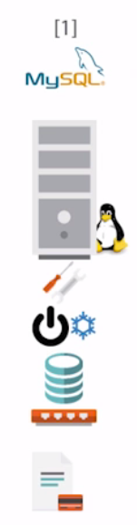
Server : Application 1 : 1

Slide 5
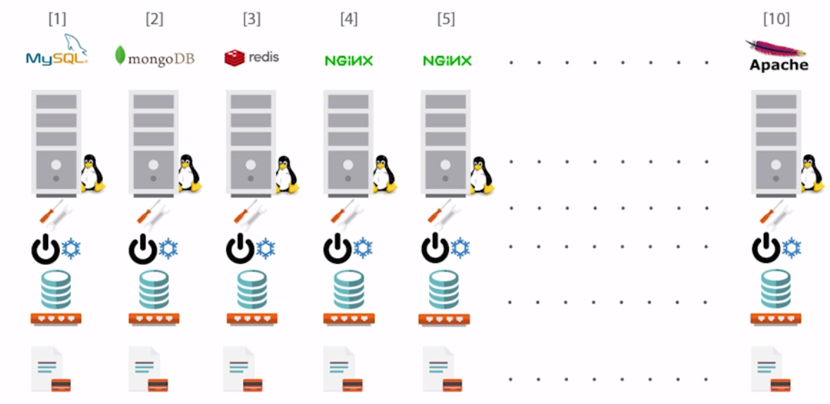
Server : Application 1 : 1

Slide 6
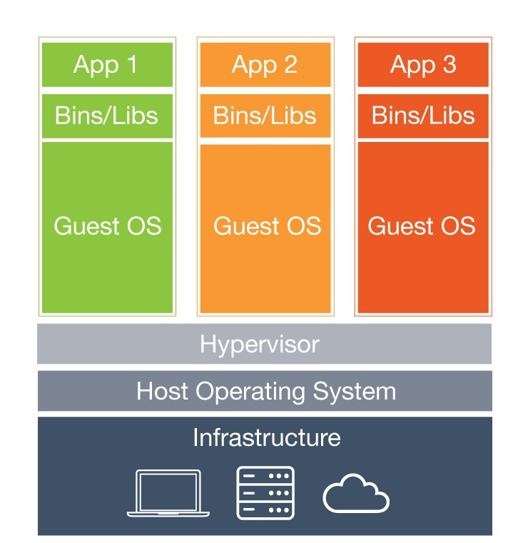
Hypervisor
Beneﬁts:
Cost-Eﬃcient
Easy to Scale
Limitations:
Kernel Resource Duplication
Application Portability Issue

Slide 7
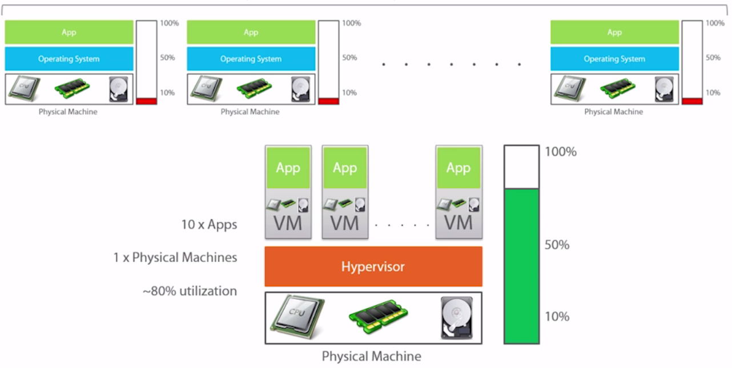
Server : Application 1 : 10
Previously
Now

Slide 8
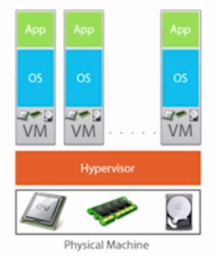
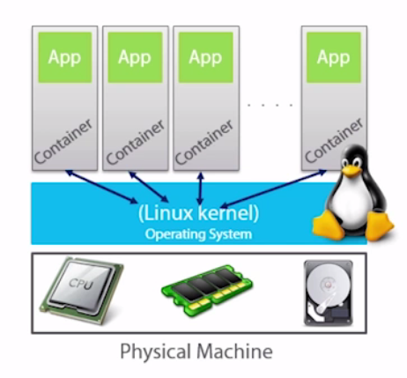
Containers
VM Model

Slide 9










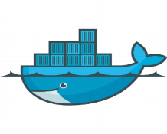


Runtime Isolation
Application A
Application A
JRE 8
JRE 7
Container A
Container B
Container Engine(Docker)
Operating System/Kernel
Physical Server

Slide 10
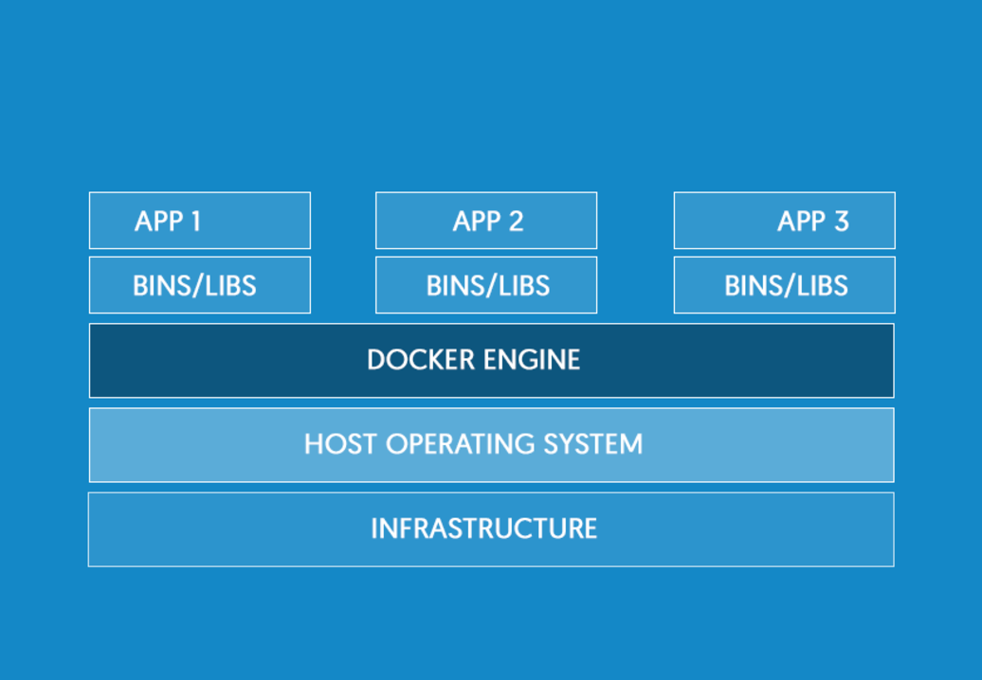

Docker
Uses resource isolation features of the Linux kernel:
namespaces,
cgroups
union file systems
Container1
Container2
Container3

Slide 11
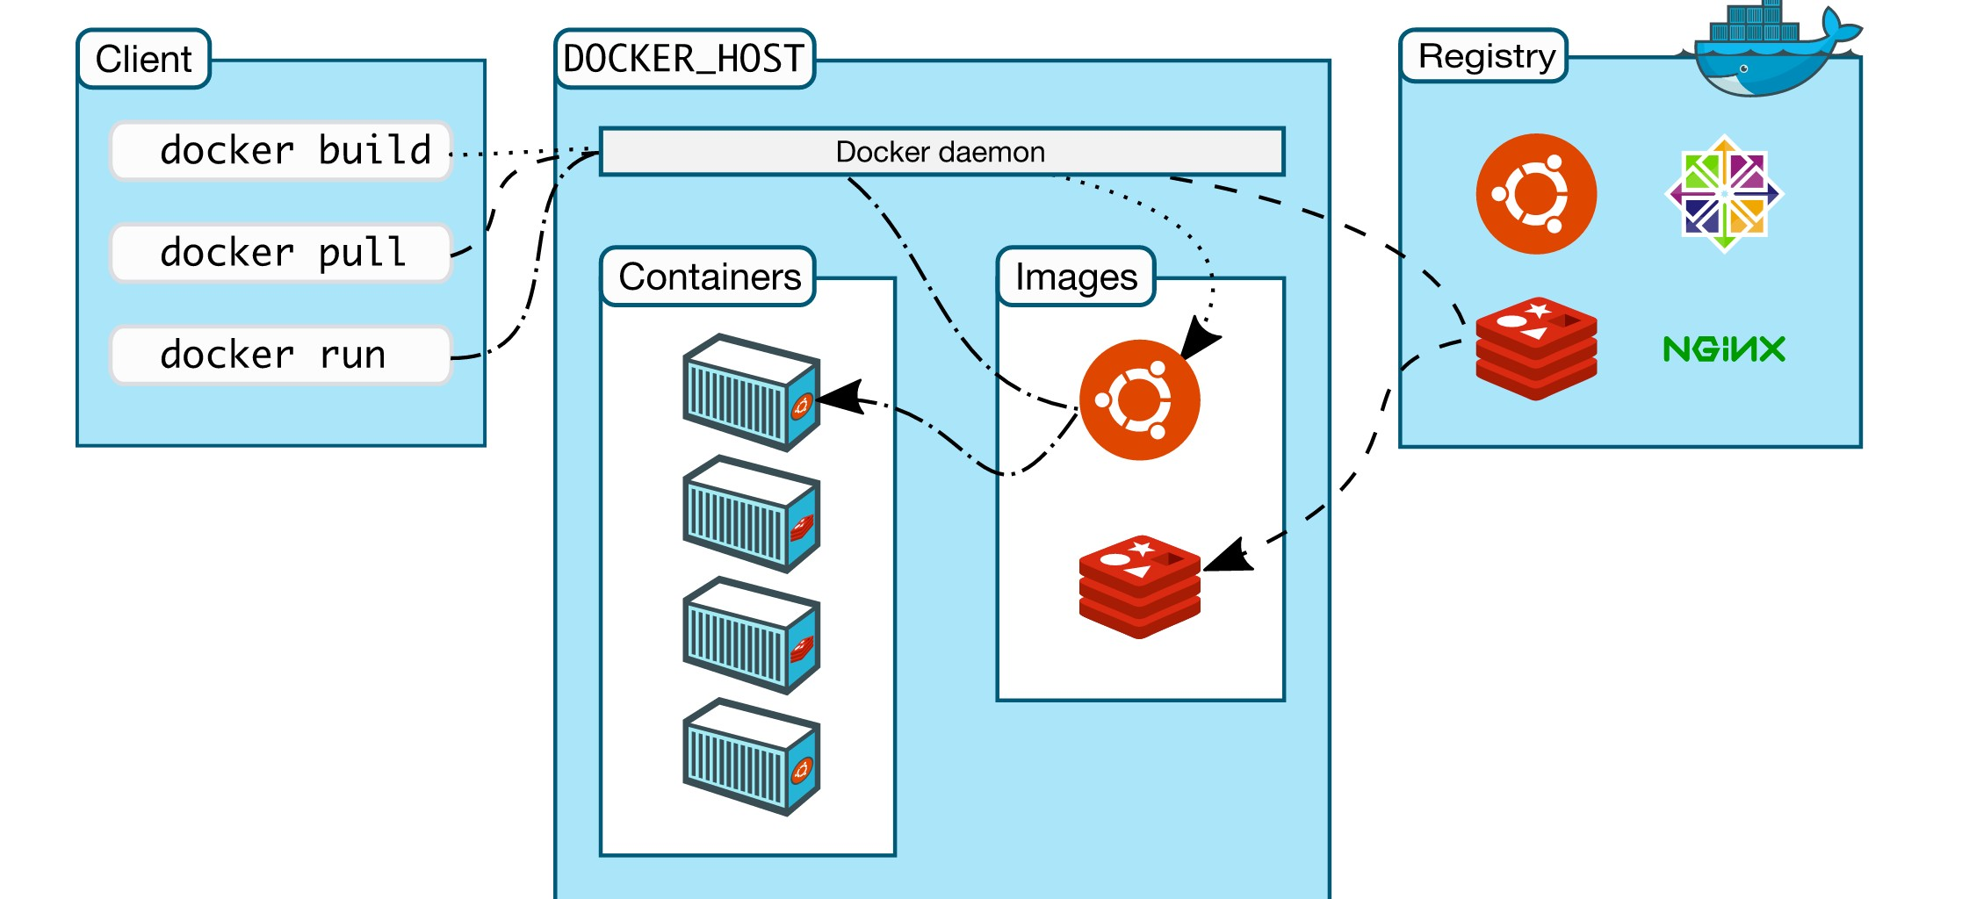
Docker Architecture
Same or different Server

Slide 12
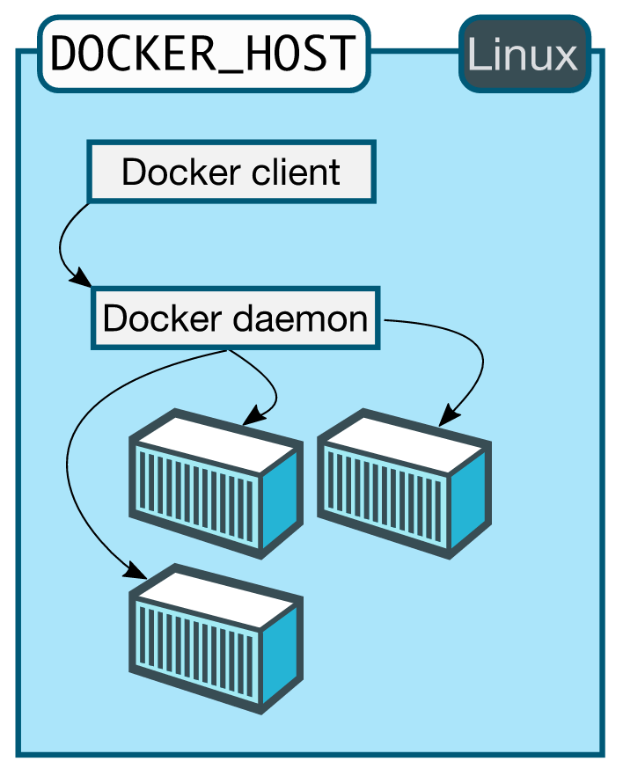
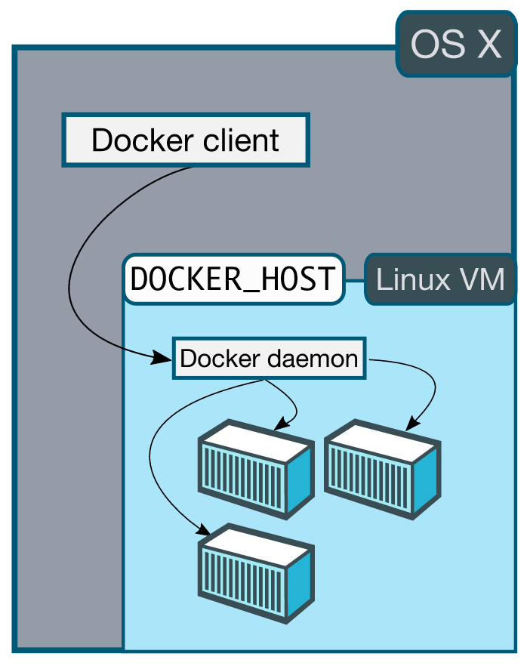
Docker Architecture

Slide 13
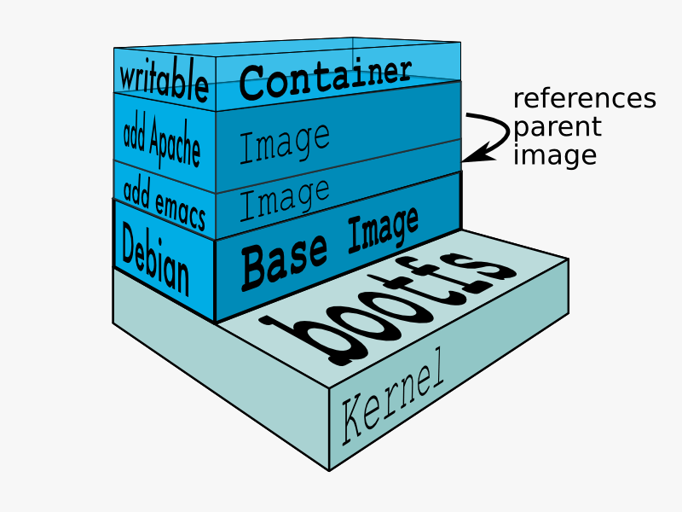
Images
Images are read only templates used to create containers
Images are composed of layers of other images
Images are stored in a Docker registry

Slide 14
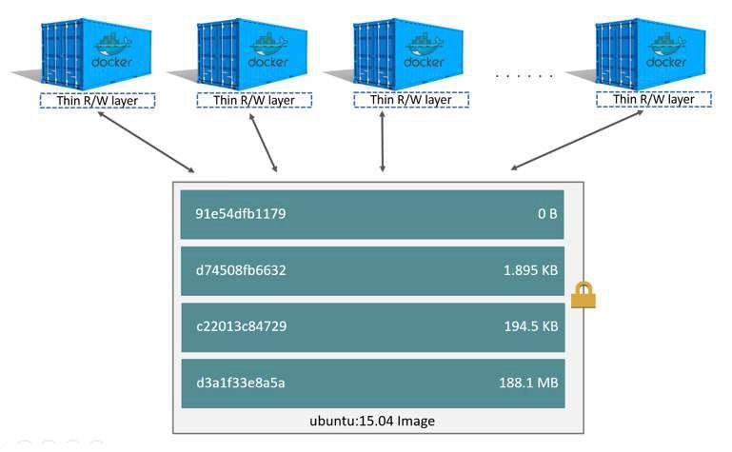
Image Layers

Slide 15
Installation

Slide 16
Demo

Slide 17
Why are containers important to your customers?
Developers
System Admins
Build and ship higher-quality apps faster
Developers can quickly build an app in any language, using any tool chain
Containerized apps are portable and can run on any Linux/Windows OS
SysAdmin use containers for their standard and simplistic deployment
Reduces the finger pointing of app dependency
Abstract away the underlying OS and hardware platform, making the application portable
DevOps Transformation

Slide 18
What Next..
Docker
Docker Hub
The Docker Book
Tutorials
Cloud Computing for Developers
Deploying & Managing Scalable Web Applications in the Cloud
Best Practices for Running Production Applications in the Cloud

Slide 19




Let’s stay connected
github.com/suman-d
suman.san14@yahoo.in
linkedin.com/in/suman-d
+91-9620102221

Slide 20
Backup

Slide 21
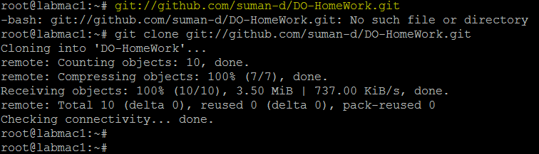
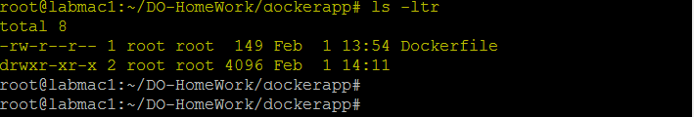

Slide 22
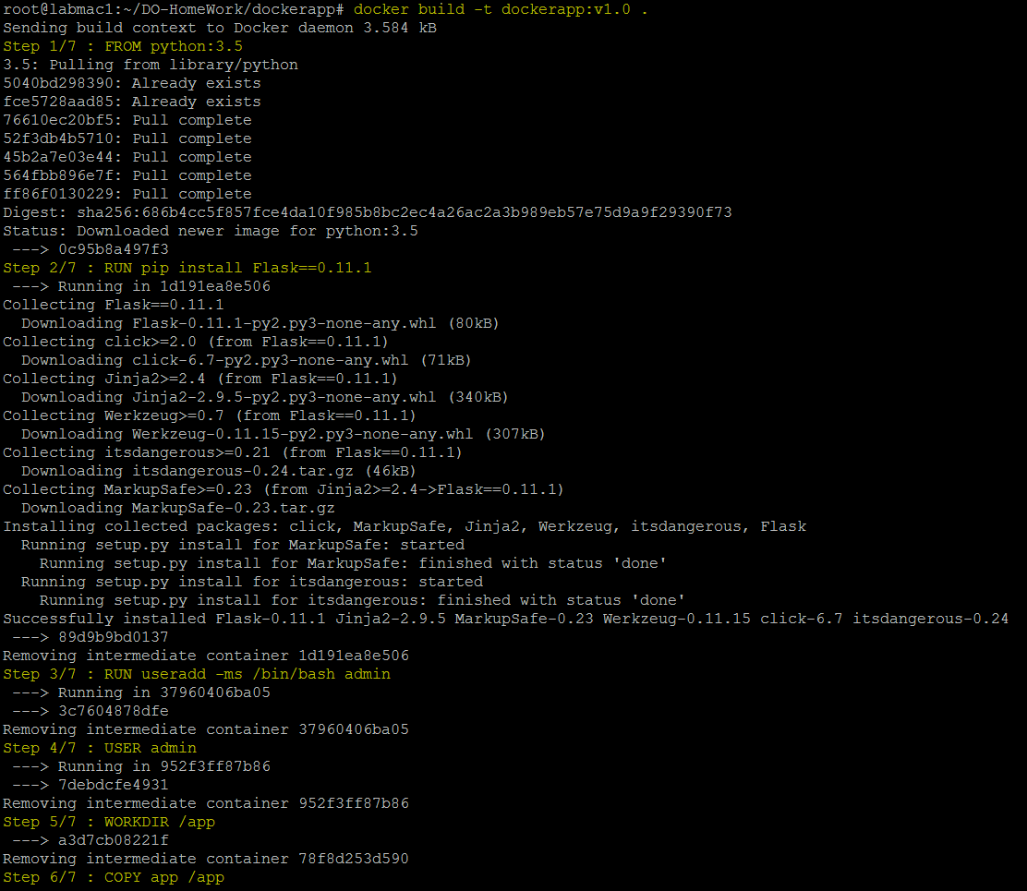

Slide 23
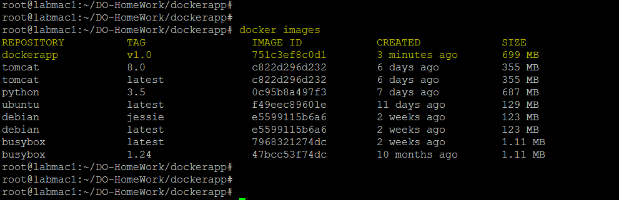
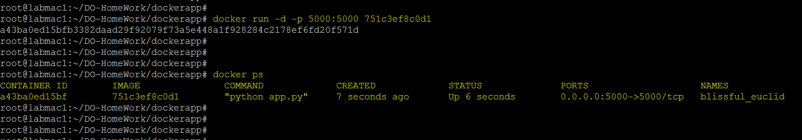

Slide 24
